Slide 1
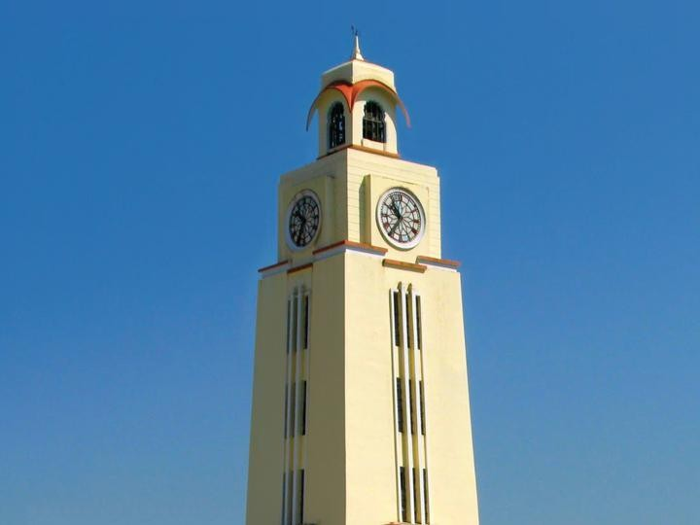

Artificial and Computational Intelligence
AIMLCZG557
Contributors & Designers of document content : Cluster Course Faculty Team
M2 : : Problem Solving Agent using Search
BITS Pilani
Pilani Campus
Presented by
Dr. Srinivasa L. Chakravarthy
Chakri.ls@wilp.bits-Pilani.ac.in

Slide 2

Artificial and Computational Intelligence
Disclaimer and Acknowledgement
Few content for these slides may have been obtained from prescribed books and various other source on the Internet
I hereby acknowledge all the contributors for their material and inputs and gratefully acknowledge people others who made their course materials freely available online.
.I have provided source information wherever necessary
This is not a full fledged reading materials. Students are requested to refer to the textbook w.r.t detailed content of the presentation deck that is expected to be shared over e-learning portal - taxilla.
I have added and modified the content to suit the requirements of the class dynamics & live session’s lecture delivery flow for presentation
Slide Source / Preparation / Review:
From BITS Pilani WILP: Prof.Raja vadhana, Prof. Indumathi, Prof.Sangeetha
From BITS Oncampus & External : Mr.Santosh GSK

Slide 3

Course Plan
M1 | Introduction to AI
M2 | Problem Solving Agent using Search
M3 | Game Playing
M4 | Knowledge Representation using Logics
M5 | Probabilistic Representation and Reasoning
M6 | Reasoning over time
M7 | Ethics in AI
BITS Pilani, Pilani Campus

Slide 4
Learning Objective
At the end of this class , students Should be able to:
Design problem solving agents
Create search tree for given problem
Apply uninformed search algorithms to the given problem
Compare performance of given algorithms in terms of completeness,
optimality, time and space complexity
Differentiate for which scenario appropriate uninformed search technique is
suitable and justify
BITS Pilani, Pilani Campus

Slide 5
Agents Architectures
BITS Pilani, Deemed to be University under Section 3 of UGC Act, 1956

Slide 6
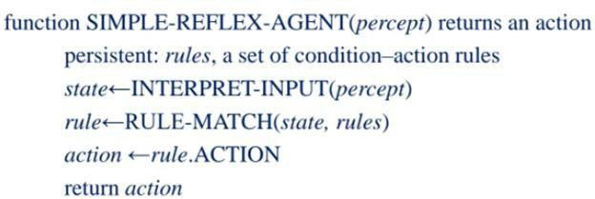
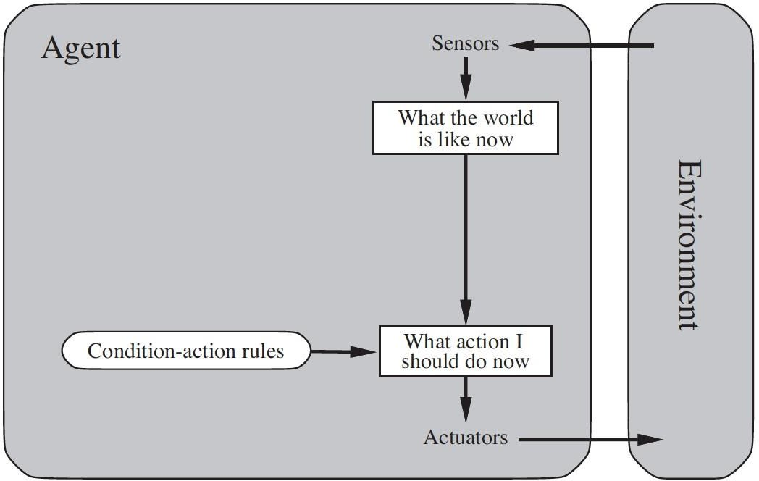
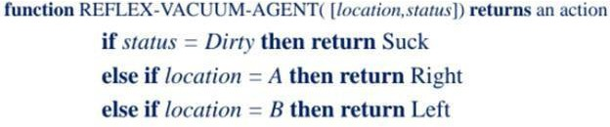
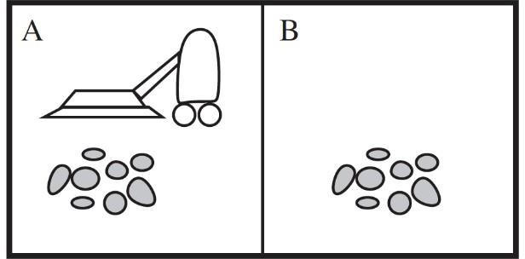
Agent Architectures
Simple Reflex Agent
Simple Reflex
Agents

Slide 7
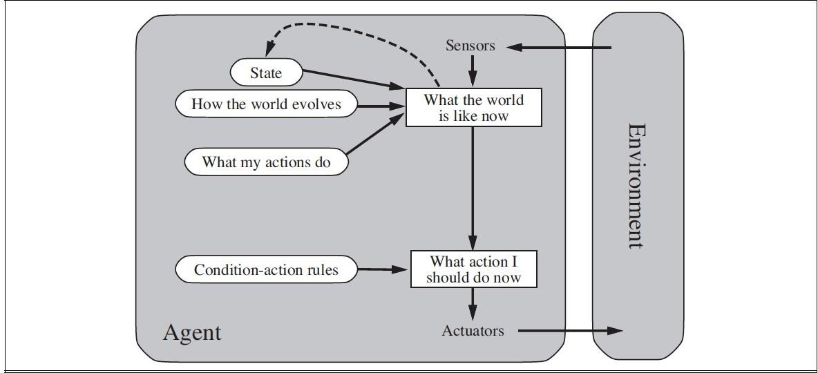
Agent Architectures
Model based Agent
Simple Reflex Agents
Model Based
Agents

Slide 8
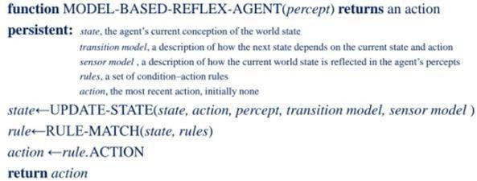
Agent Architectures
Model based Agent

Slide 9
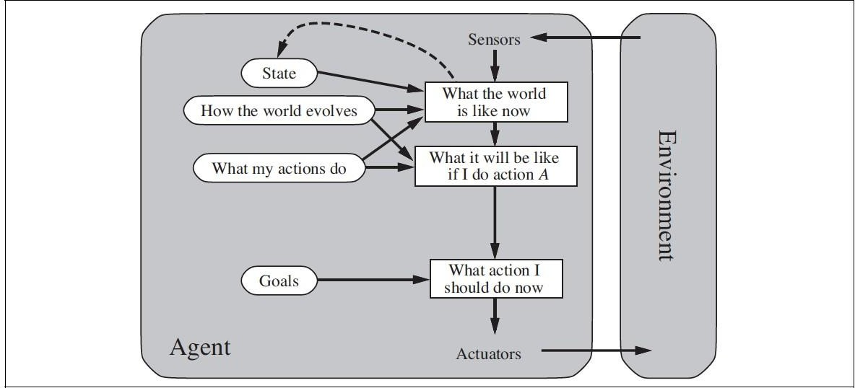
Agent Architectures
Goal based Agent
Simple Reflex
Agents
Model Based
Agents
Goal Based
Agents

Slide 10
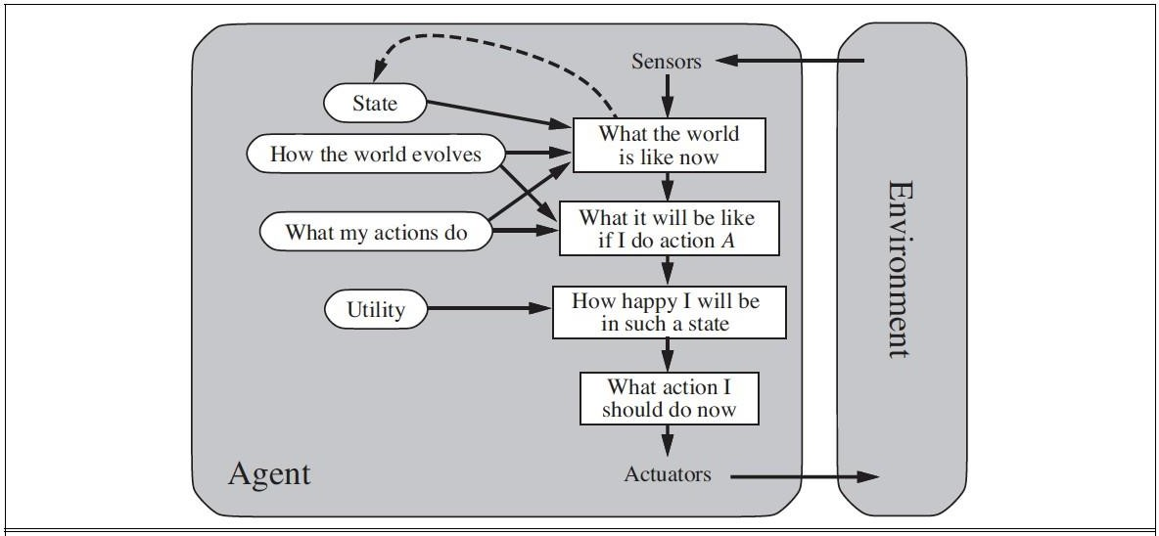
Agent Architectures
Utility based Agent
Simple Reflex
Agents
Model Based
Agents
Goal Based Agents
Utility Based
Agents

Slide 11
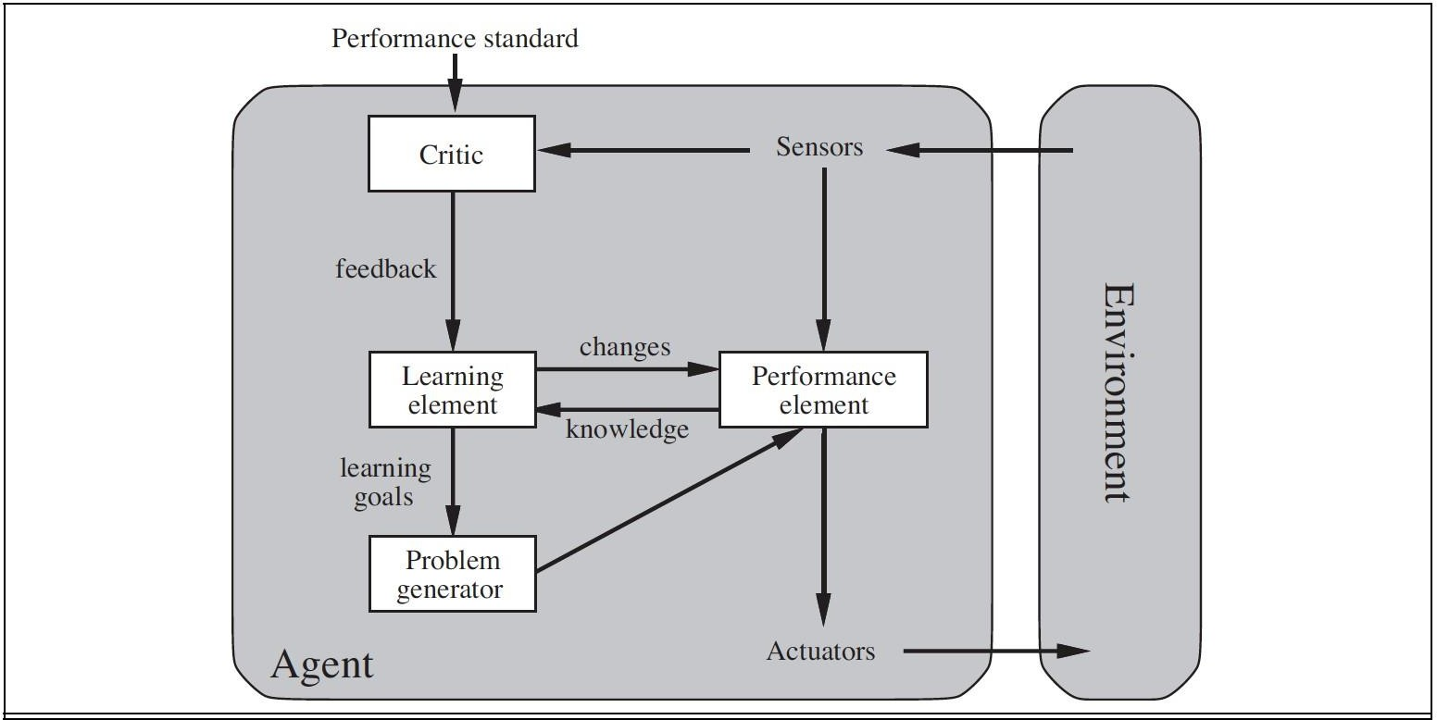
Agent Architectures
Learning Agent
Simple Reflex Agents
Model Based Agents Goal Based Agents
Utility Based Agents
Learning Agents

Slide 12

Role of Learning
Performance Element – taking a decision of action based on percepts
Learning Element – Make the performance element select better actions such that the utility function is optimized
Critic – Provides feedback on the actions taken
Problem Generator – Make the Performance Element select sub-optimal actions such that you would learn from unseen actions

Slide 13
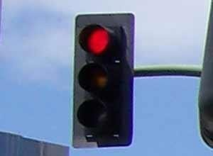
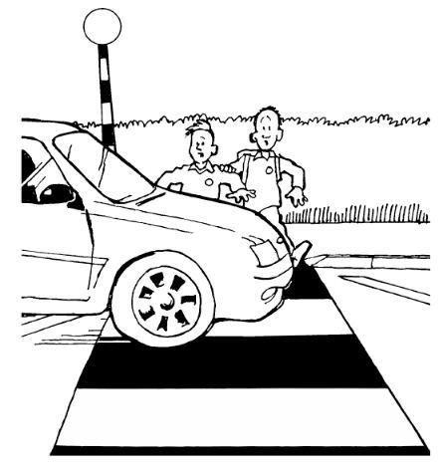
Role of Learning
Agents that improve their performance by learning from their own experiences
Input Percept
Output Action
Performance
Element
APPLY BRAKE
Resulting State
Feedback
Critic
-2

Slide 14
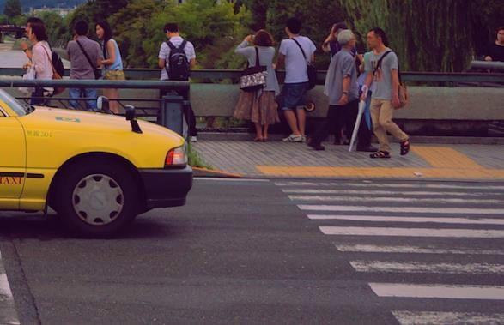
Role of Learning
Input Percept
Possible Actions
Brake
Change Gear to Lower Change Gear to Higher
Selected Action
Accelerate Steer left Steer right
Random
Change Gear to Lower

Slide 15
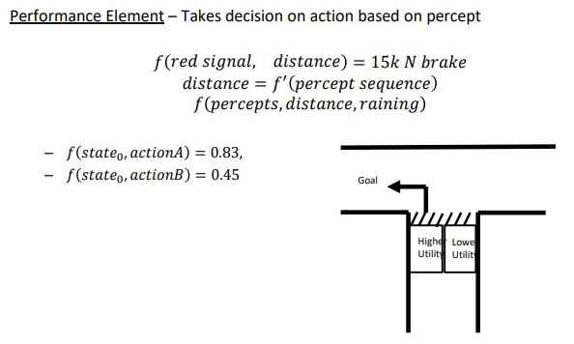
Role of Learning

Slide 16
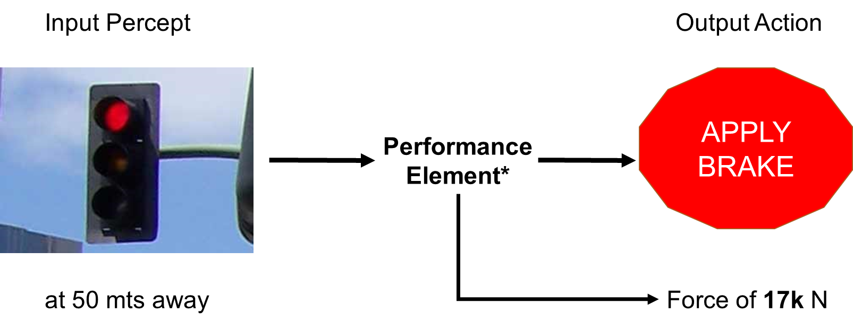
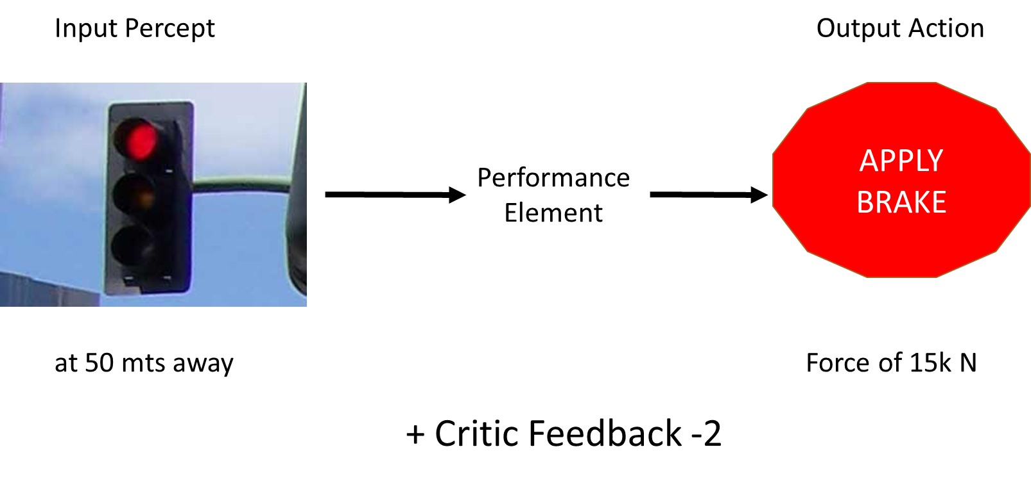
Role of Learning
Learning : Supervised Vs Unsupervised Vs Reinforcement

Slide 17
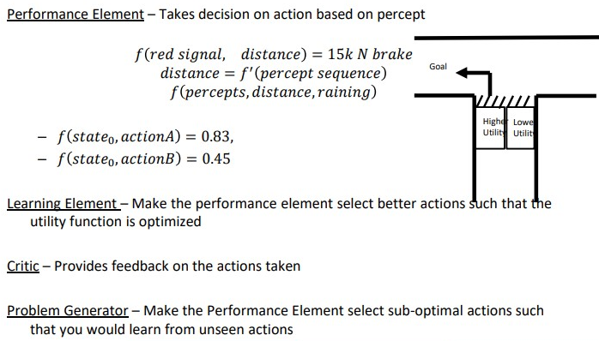
Role of Learning

Slide 18

Problem Formulation
BITS Pilani, Deemed to be University under Section 3 of UGC Act, 1956

Slide 19
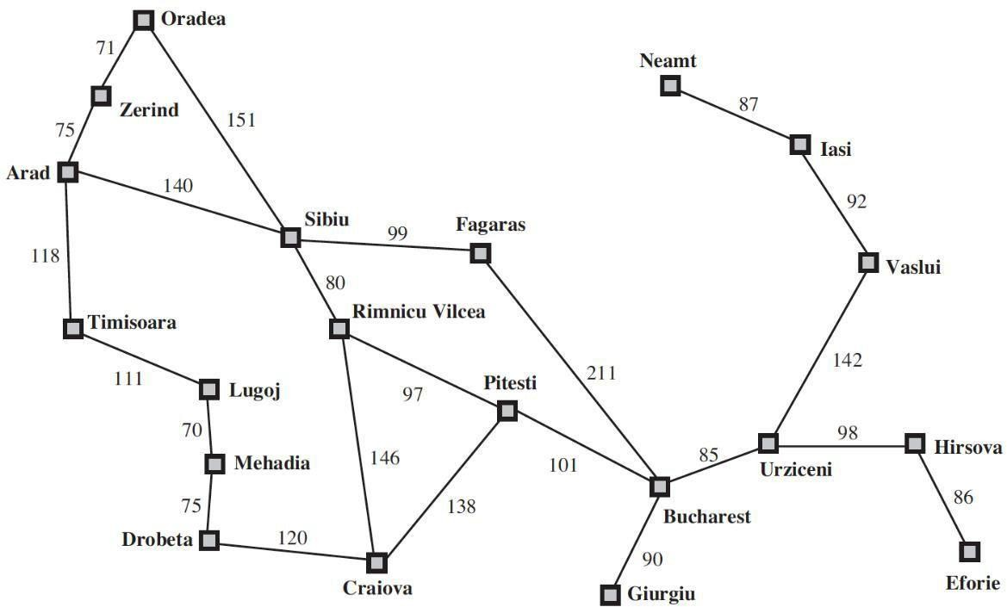
Problem Solving Agents
Goal based decision making agents finds sequence of actions that leads to the desirable state.
Phases of Solution Search by PSA
Goal
Formulation
Optimizes the Objective (Local |
Global) Limits the Actions
Problem
Formulation
Search Phase
Execution
Phase

Slide 20
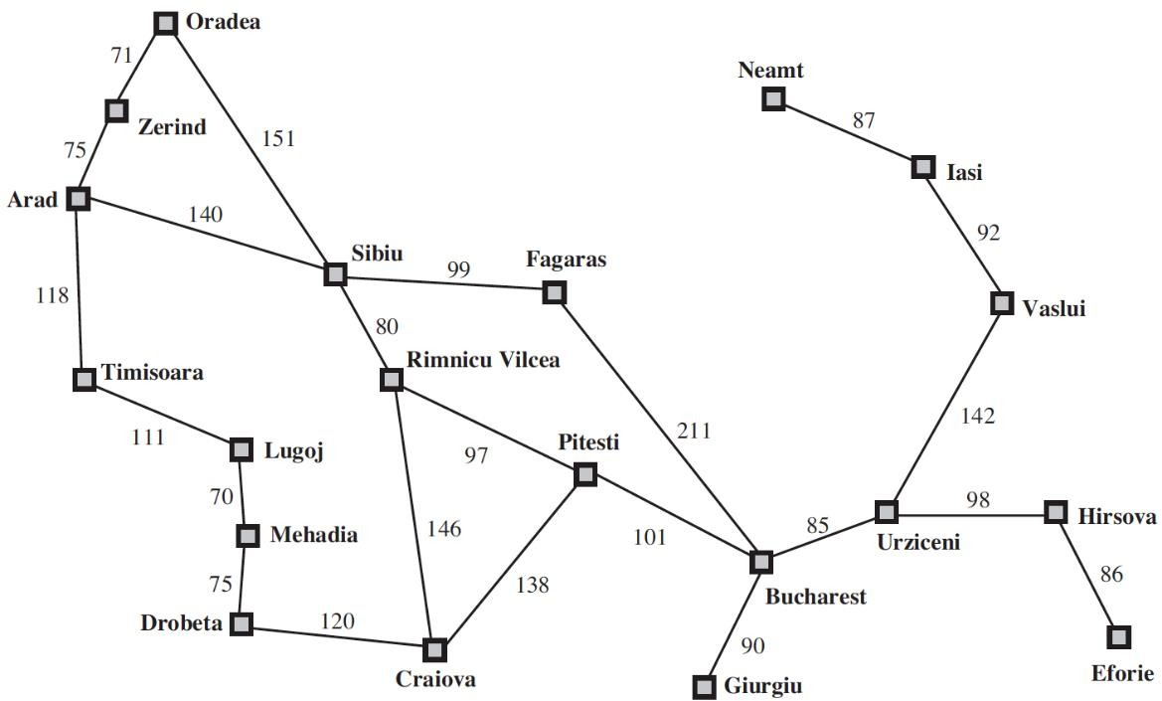
Problem Solving Agents
Phases of Solution Search by PSA
Goal Formulation
Problem
Formulation
State Space Creations [in the path of Goal]
Lists the Actions
Search
Phase
Execution
Phase

Slide 21
Problem Solving Agents
Phases of Solution Search by PSA
Goal
Formulation
Assumptions – Environment :
Static
Observable Discrete
Deterministic
Problem
Formulation
Search
Phase
Execution
Phase

Slide 22
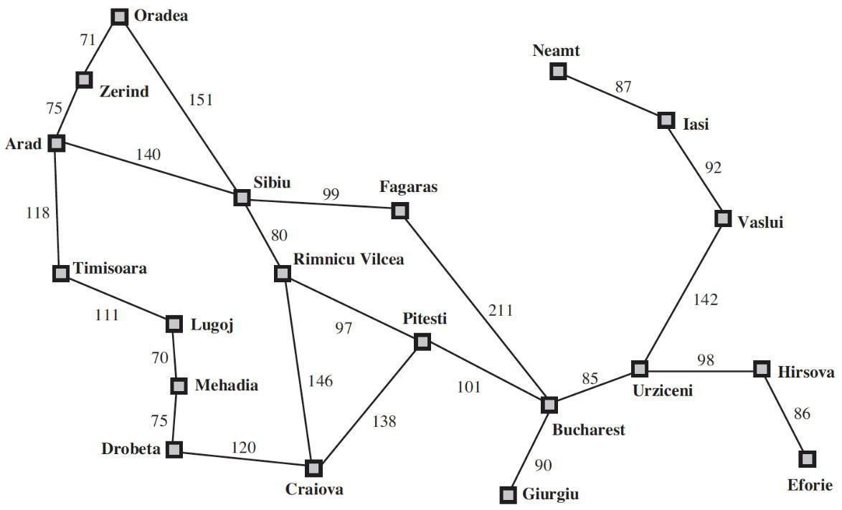
Problem Solving Agents
Phases of Solution Search
Goal
Formulation
Problem
Formulation
Search
Phase
Examine all sequence Choose best | Optimal
Execution
Phase

Slide 23
Problem Solving Agents – Problem Formulation
Abstraction Representation
Decide what actions under states to take to achieve a goal
5 Components
Initial State
Possible
Action
| Operators
Successor
Function
|Transition
Model
Goal Test
Path Cost
A function that assigns a numeric cost to each path. A path is a series of actions.
Each action is given a cost depending on the problem.
Solution = Path Cost Function + Optimal Solution

Slide 24
Problem Solving Agents – Problem Formulation: Book Example
Initial State –E.g., In(Arad)
Possible Actions – ACTIONS(s) → {Go(Sibiu), Go(Timisoara), Go(Zerind)}
Transition Model – RESULT( In(Arad), Go(Sibiu) ) = In(Sibiu)
Goal Test – IsGoal( In(Bucharest) ) = Yes
Path Cost – cost( In(Arad), go(Sibiu)) = 140 kms

Slide 25
Example Problem Formulation
 | Travelling Problem
Initial State | Based on the problem
Possible Actions | Take a flight | Train | Shop
Transition Model/ Successor Function | [A, Go(A->S)] = [S]
Goal Test | Is current = B (destination)
Path Cost | Cost + Time + Quality

Slide 26
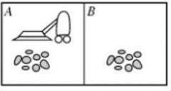
Example Problem Formulation
 | Vacuum World
Initial State | Any
Possible Actions | [Move Left, Move Right, Suck, NoOps]
Transition Model/ Successor Function | [A, ML] = [B , Dirty] [A, ML] = [B, Clean]
Goal Test | Is all room clean? [A, Clean] [B, Clean]
Path Cost | No of steps in path

Slide 27
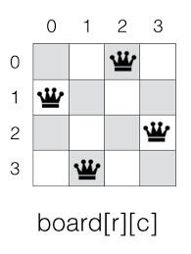
Example Problem Formulation
 | N-Queen
Initial State | Empty | Partial | Full
Possible Actions
Transition Model/ Successor Function
Goal Test
Path Cost

Slide 28


Path finding Robot
Successor Function Design
1 | 2 | 3 | 4 | 5 | 6 | 0
 | 8 |  | 10 | 11 | 12 | 1
13 | 14 |  | 16 | 17 | 18 | 2
19 | 20 |  | 22 | 23 | 24 | 3
25 | 26 | 27 |  |  | 30 | 4
 | 32 | 33 |  | 35 | 36 | 5
37 | 38 | 39 | 40 | 41 | 42 | 6
0 | 1 | 2 | 3 | 4 | 5
N-W-E-S

Slide 29

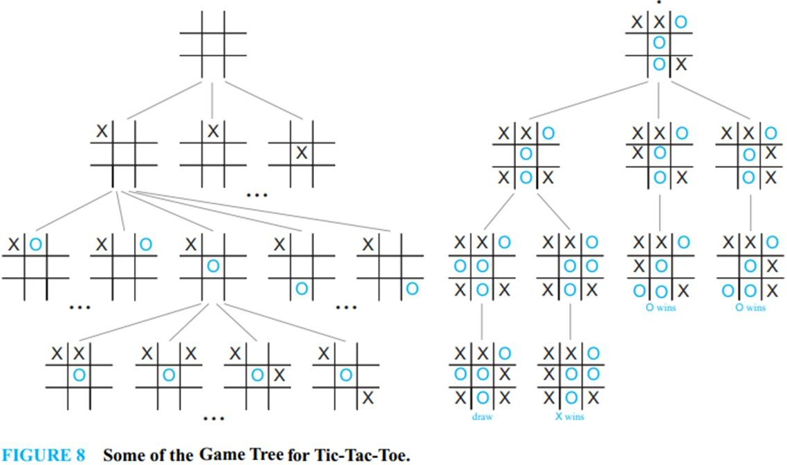
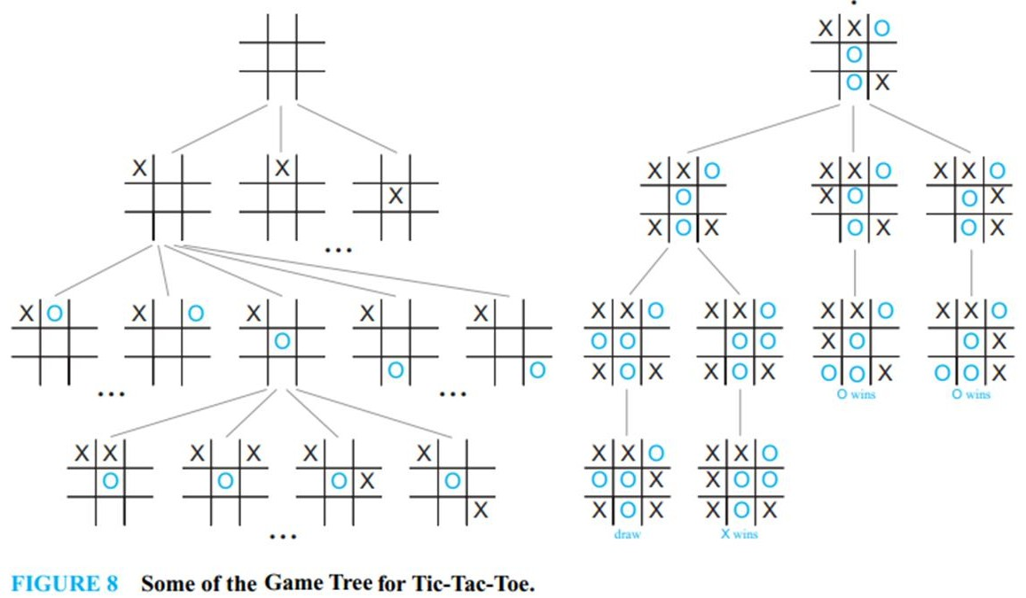
Graph Searching
Graph as state space (node = state, edge = action)
For example, game trees, mazes, ...
BITS Pilani, Deemed to be University under Section 3 of UGC Act, 1956

Slide 30
Searching for Solutions
Choosing the current state, testing possible successor function, expanding current state to generate new state is called Traversal. Choice of which state to expand – Search
Strategy
Search Strategy (under certainty)
Uninformed (will be discussed in
next class)
BFS, DFS, UCS
IDS, DLS
Bi-Directional
Informed (will be discussed in
next class)
Best First Search A*
BITS Pilani, Pilani Campus

Slide 31

In(Arad)
Go(Sibiu)
Go(Timisoara)
Go(Zerind)
In(Sibiu)
In(Timisoara)
In(Zerind)
Go(Arad)
Go(Fagaras
Go(Oradea)
Go(Rimnicu Vilcea)
)
In(Arad)
In(Fagaras
In(Oradea)
In(Rimnicu Vilcea)
)
Leaf Nodes
(no children yet)
BITS Pilani, Pilani Campus

Slide 32

Next Class Plan
Uninformed Search Algorithms
BFS vs DFS – An overview
Uniform Cost Search
Iterative Depth First Search
Informed Search Algorithms
Greedy Best First search
A* Search (Start)
BITS Pilani, Pilani Campus

Slide 33
Required Reading: AIMA - Chapter #1, 2, 3.1, 3.2, 3.3
Thank You for all your Attention
Note : Some of the slides are adopted from AIMA TB materials
BITS Pilani, Pilani Campus

